Slide 1
Chongqing University of Technology
ATAI
Advanced Technique of Artificial Intelligence
Chongqing University of Technology
MuLe: Multi-Grained Graph Learning for Multi-Behavior Recommendation
Code： https://github.com/geonwooko/MULE
—— CIKM 2024
2024.12.1 • ChongQing
Reported by Peng Shan

Slide 2
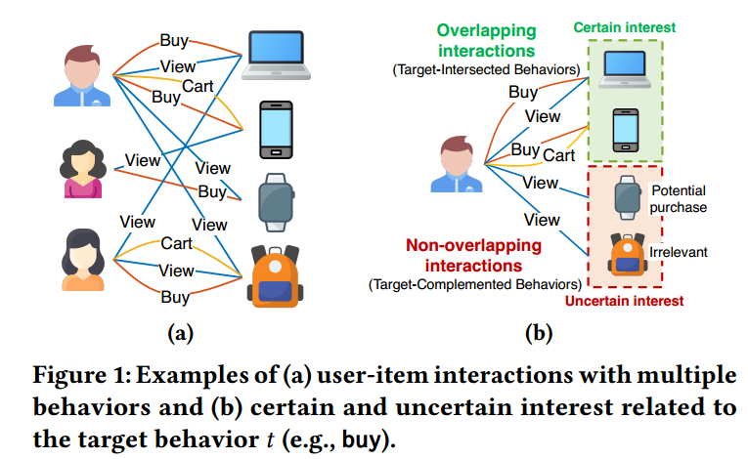
Motivation
（1） The previous methods are limited in their ability to comprehensively integrate such multi-faceted relationships when encoding embeddings.
（2）They still face challenges in handling uncertain auxiliary interactions that could potentially lead to purchases or not.

Slide 3
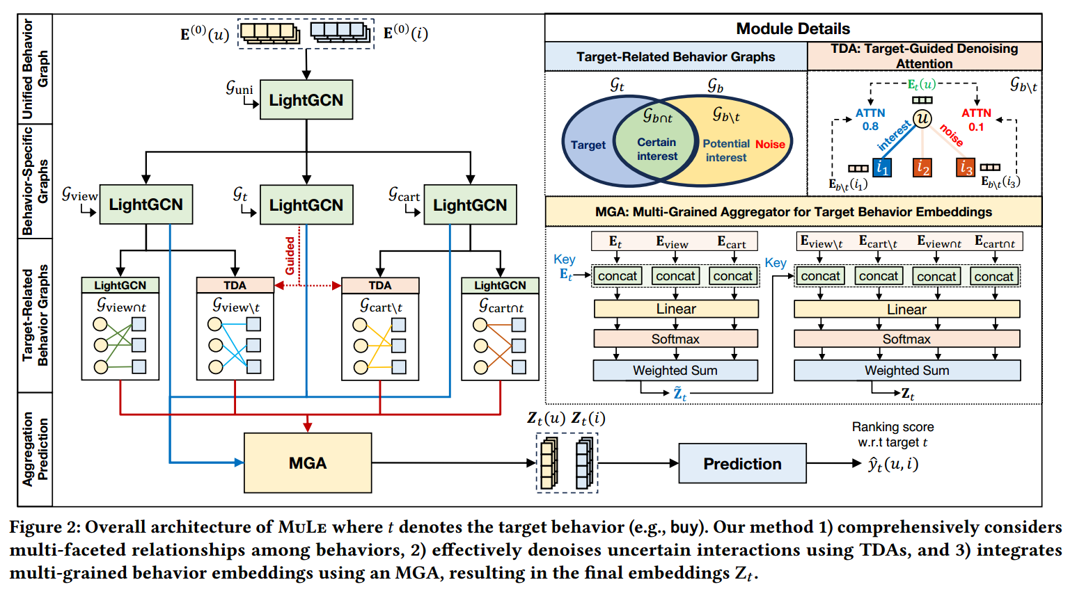
Method

Slide 4
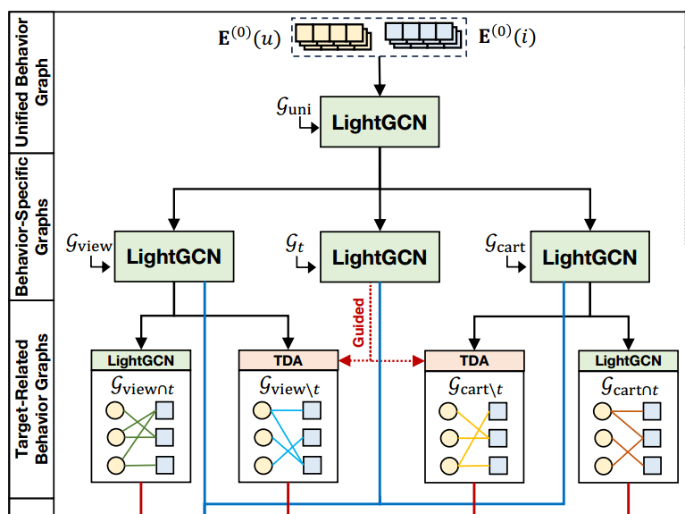
Method

Slide 5
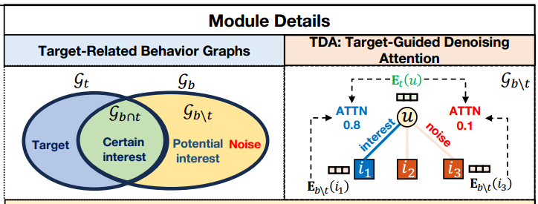
Method

Slide 6
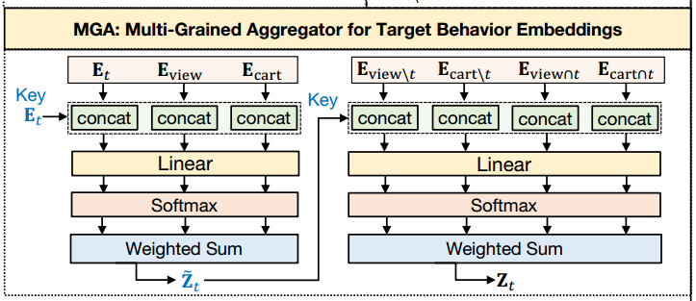
Method

Slide 7
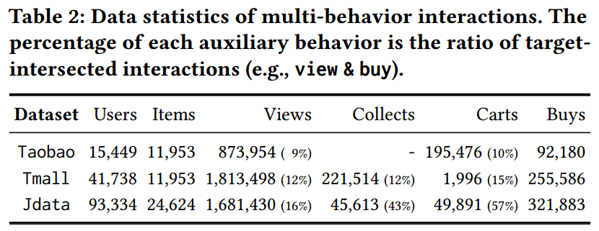
Experiments

Slide 8
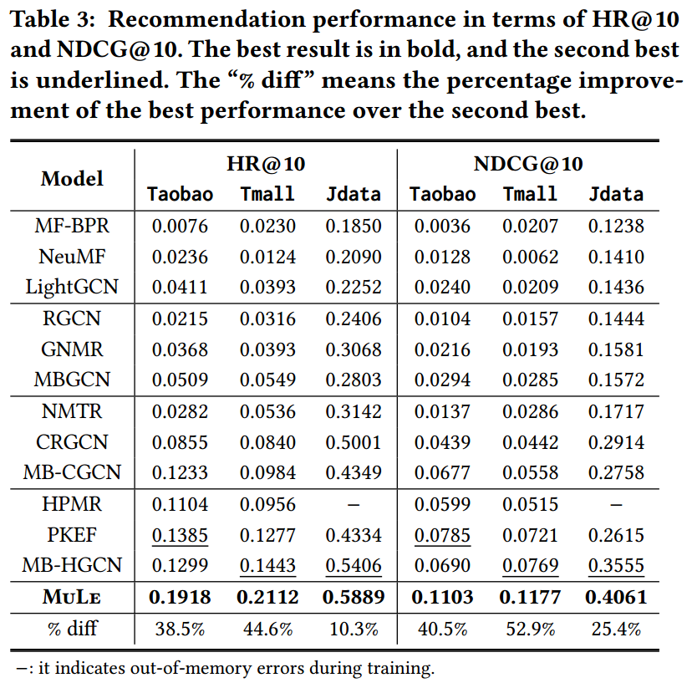
Experiments

Slide 9
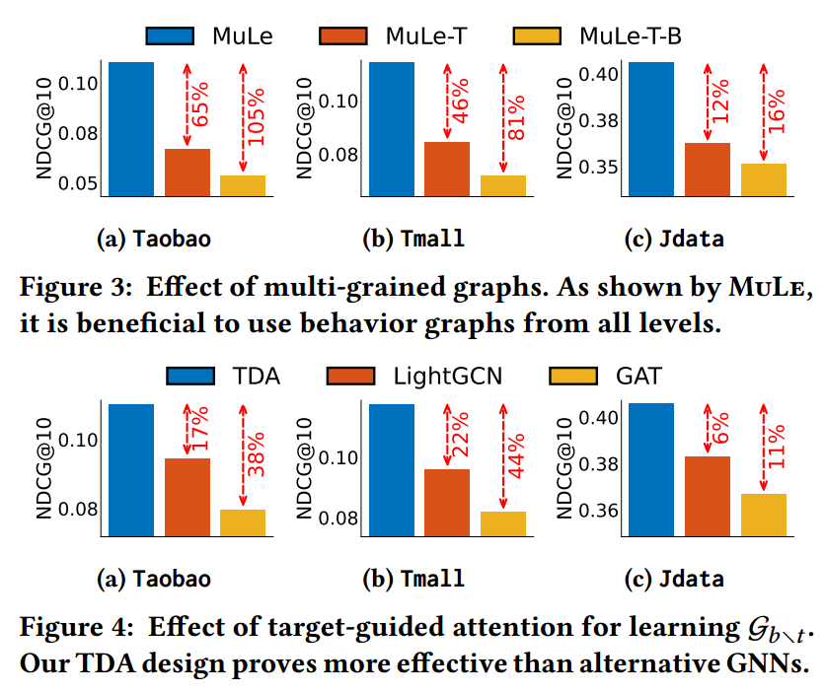
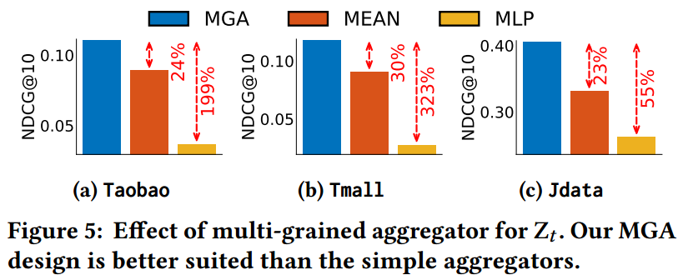
Experiments

Slide 10
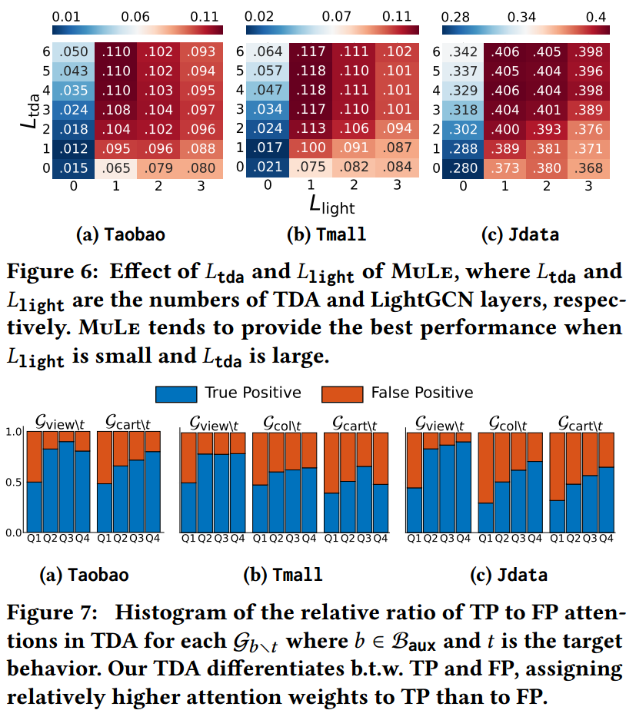
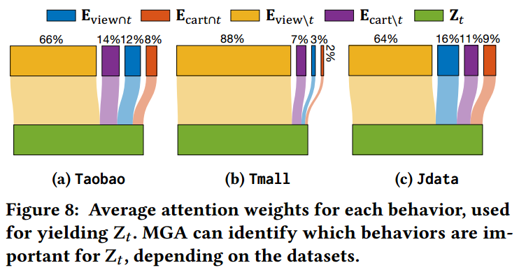
Experiments

Slide 11
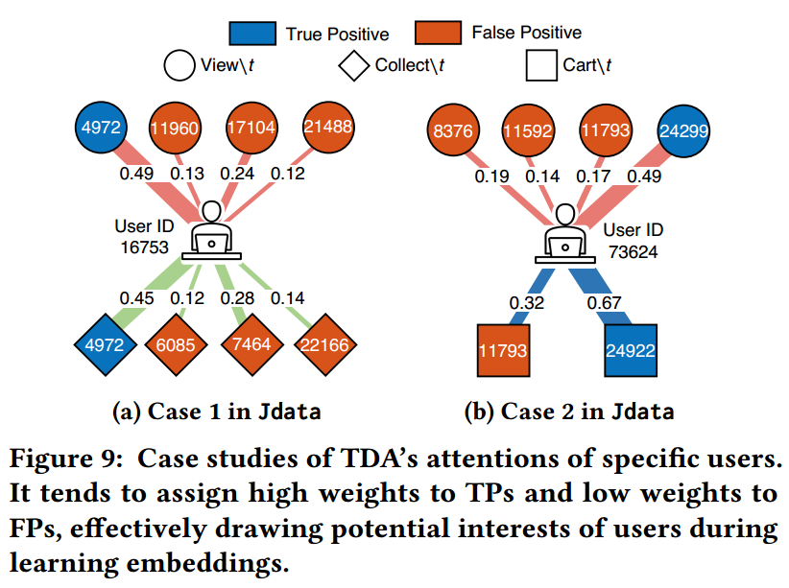
Experiments

Slide 12
Thanks!

